Slide 1
ETL
Extract, Transform, Load

Slide 2
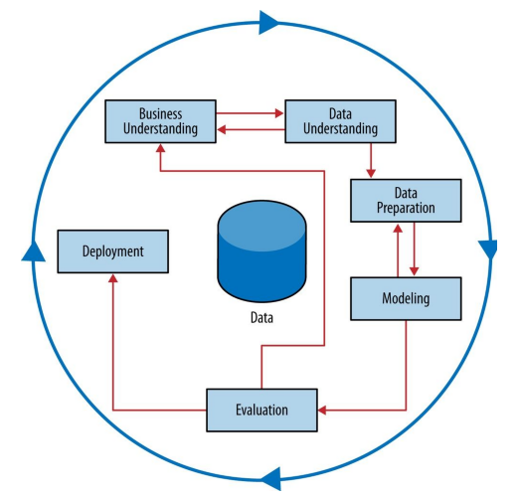

Slide 3
First, some keywords
“Features” – the things you are using to make predictions
columns in a spreadsheet, variables, etc
“Target variable” – the thing you are trying to predict
e.g., predict income, likelihood to default on loan

Slide 4
What is ETL? Summary
Extract
Pull data out of wherever it resides in the world
Transform
Convert data into homogenous format for joining
Do stuff to the data
Create new “features” (variables)
Load
Put clean data into final location
In other words, “Get data, do stuff to it, put it somewhere else”

Slide 5
TRANSFORM
Do stuff to it
combine
clean up
make new “features”
EXTRACT
Gather Data
LOAD
Put somewhere useful

Slide 6
Extract

Slide 7
Where does data come from?
Credit card company, customer asking for a credit line increase. “Should we grant this person credit?”
Name some internal data sources
Name some external data sources
“Extracting data” is just obtaining the data, in the format you want
What kinds of formats of data are you aware of?
CSV (delimitiers)
spreadsheet
database
JSON
text
CSV example:
Year,Make,Model
1997,Ford,E350
2000,Mercury,Cougar
Notes:
pay for experimentation
Capital One experimentation
purchase external
demographic, vehicle, household economic (credit cards), purchase data, home data

Slide 8
Transform

Slide 9
Transform
Clean it!
Data starts out messy.
Data is from multiple sources or tables.
Data is text. Computers like numbers, not text.
Combine it!
Transform it!
https://help.alteryx.com/11.7/Reference/DataFieldType.htm

Slide 10
Transform -- Impute missing data
Let’s say I know everyone’s age in this class except for the age of one person. What would be a good guess for that age?
Let’s say I also know everyone’s age and class standing, and I have another student for whom I know the class standing but not the age. What would be the best guess for age?
That’s imputation! Just making “best guesses” for non-target features.

Slide 11
Transform – flat table
Machine learning algorithms require one single “flat” table – like a single sheet from an excel workbook.
You have to turn your stuff into “tabular” format
You need to “merge” tables
https://help.alteryx.com/11.7/Reference/DataFieldType.htm

Slide 12
Transform – flat table
Normalize and scale values for comparability
Say I have both “age” and “income” in a model, and I am trying to predict IQ score
Say that I want to compare the predictiveness of “age” vs “income”
Problem is that the numbers are on vastly different scales. How might I put them on the same scale for comparability?
https://help.alteryx.com/11.7/Reference/DataFieldType.htm

Slide 13
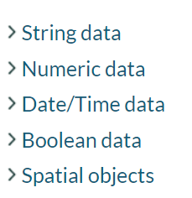
Transform
Convert data types. Data comes in many types
https://help.alteryx.com/11.7/Reference/DataFieldType.htm

Slide 14
Continuous vs Discrete
Continuous
Infinite number of possible responses
Like any point on a number line
Discrete
Finite number of options
Examples: course letter grade, country of origin, or Likert scale

Slide 15
Types of Discrete Data
Categorical (a.k.a Nominal)
You can identify groups are different, but no meaningful ranking
Examples
Occupation {teacher, dentist, data scientist, student…}
Marital status {single, married, divorced, widowed}
CustomerId {1, 2, 3,…, n}
Binary data
Nominal attribute with only two categories/states
0 -> no 1 -> yes
Boolean (when states are represented as true or false]

Slide 16
Types of Discrete Data
Ordinal
Meaningful order, but distance is unequal
Likert scales: Disagree; Somewhat disagree; Neutral; Somewhat agree; Agree
Army Rank: Private; Private first class; Specialist; Corporal; Sergeant…
Grades: A; A-; B+
Customer satisfaction: 0: very dissatisfied; 1: somewhat dissatisfied; neutral;..
Interval
In addition to order, you know space between groups is even
Example: Dates; temperatures
Ratio
“Double” makes sense
40*C is not “double” 20*C
Examples: Years work experience, number of words in an article, height/weight

Slide 17
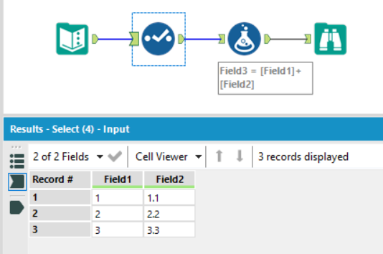
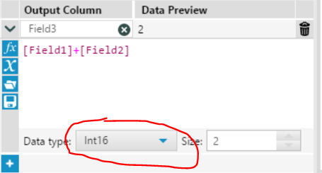
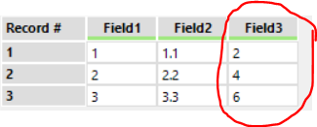
Numeric Data
Integer vs Real
Are decimals allowed?
Exact vs Approximate and Precision
Is rounding allowed?
How detailed do you store it?
Gotcha’s
If you want to do math in Alteryx, must be numeric type
INTs will round!!!!! Take great caution!
Doubles vs floats vs integers

Slide 18
Categoricals as Numbers
Huge Warning!!!!!
Let’s say your data has a feature called “product category”
If you ask a model to predict “daily sales” by “product category” numerical code, and you let your ML tool try to discern datatype itself, what do you think might happen?
Mind the Datatype!!!
OH NO
Product Category | Corresponds to
1 | Hats
2 | Books
3 | Garden

Slide 19
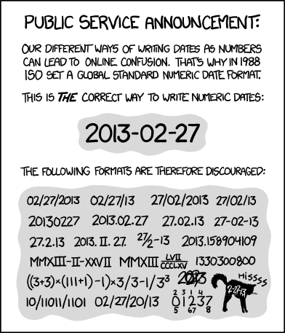
Date and Time
Usually stored internally as an unsigned integer (number of seconds since 1970)
Date and time lead to conversion nightmares because of how many formats there are

Slide 20
Text (Strings)
You specify a number of characters
This is either exact or a maximum depending on the data type
Varchar, variable length string, text varying, VSTR, and other names for variable length
You will almost always have to convert text or extract text to make something useful out of it

Slide 21
Other Datatypes
Spatial Objects
Points, lines, and shapes
Arbitrary Data
Images, movies, files

Slide 22
Other Considerations
Nullability
Does it make sense to not have a value?
Uniqueness
Can more than one row have the same value?

Slide 23
Loading
Loading data is just getting it from one source into another
Like outputting to a CSV
Or writing to a database
Or connecting to a web API
In this class, you will exclusively save your output to CSV.

Slide 24
Alteryx

Slide 25
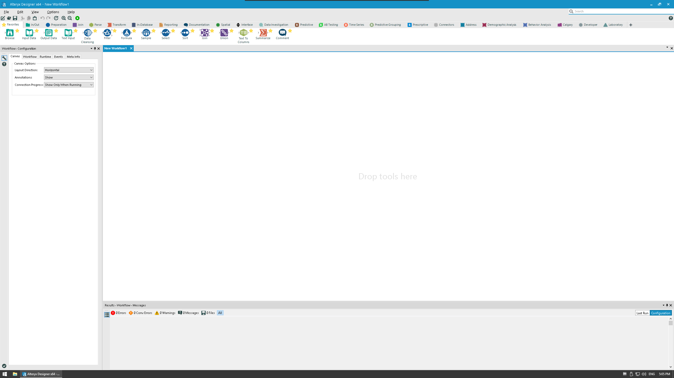

Slide 26
Let’s see datatypes in Alteryx
Sample Workflows > Learn one tool at a time > Preparation > Select
Remember, the first thing you do is “Select”

Slide 27
Download some data
https://canvas.colorado.edu/files/1556286/download?download_frd=1

Slide 28

In/Out Tools
These tools allow the input and output of data and generally start and end a workflow.
Tools:
Input data - Connect and import data from a file or database
Text input - Manually add a bit of data
Directory - input names of files, etc. from a directory
Date time now - Insert current date and time
Browse - Look at the data

Slide 29
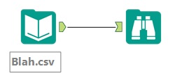
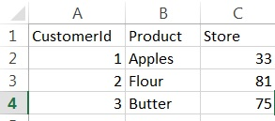
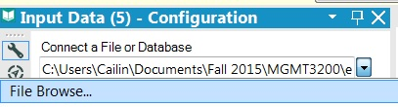

Tool: Input data
Data before (in excel doc):
Tool configuration:
Data after (in Alteryx):
Or just drag-drop the csv onto your Alteryx workflow!
Problem:
Need to open a CSV file in alteryx to run analytics on the data.
Tool description:
Connect and import data from a file or database. Puts file in alteryx for you to work with

Slide 30
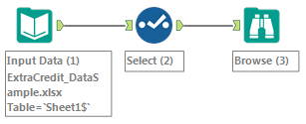
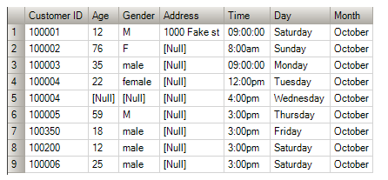
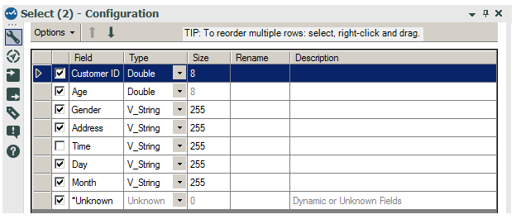
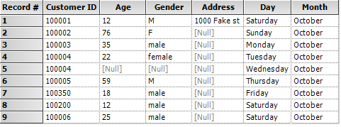
Tool: Select
Data before:
Tool configuration:
Data after:
Problem:
We no longer want the “time” column in our data set. Or we want to rename a column
Tool description:
This tool allows you to remove columns that you deem to be unnecessary. In addition, it allows for you to change the data types [More on those later], rename your variables, and change the order of columns.

Slide 31
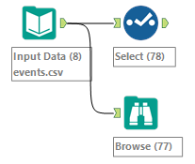
Let’s examine the content of the file
To examine the output data in its entirety, use the “Browse” tool
Or just click on the final node and select “output” for a sample
To examine the data types, use the “Select” tool
Connect both to your Input Data
Click the “run” button (green circle with white arrow) and examine results
or ctrl+r
Tasks and questions
Get rid of timestamp and prove that you succeeded
How many rows do you have?
What datatypes do you have?
Rename longitude and latitude into lon and lat.
Change lon and lat into “Float” data type

Slide 32
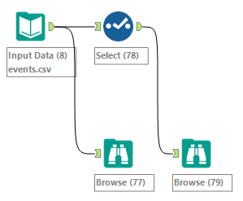
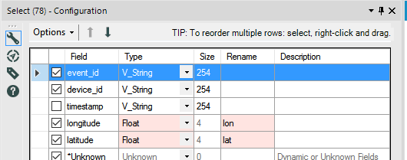

Slide 33
Sample Workflows from Homework
Learn one tool at a time
In/Out
Browse
Directory
Text Input
Output Data
Preparation
Select
Autofield
Imputation
Documentation
Comment
Tutorials
Viewing Data

Slide 34
After this class, you should be able to:
Find Help and Tutorials documentation in Alteryx
Use the tools we covered
Understand datatypes
More on Transformations practice next class

Slide 35
If time…
Explore the ClassicModels dataset
http://www.richardtwatson.com/dm6e/images/general/ClassicModels.png
Download here
Extract zip… drag-and-drop multiple files to alteryx workflow

